Slide 1
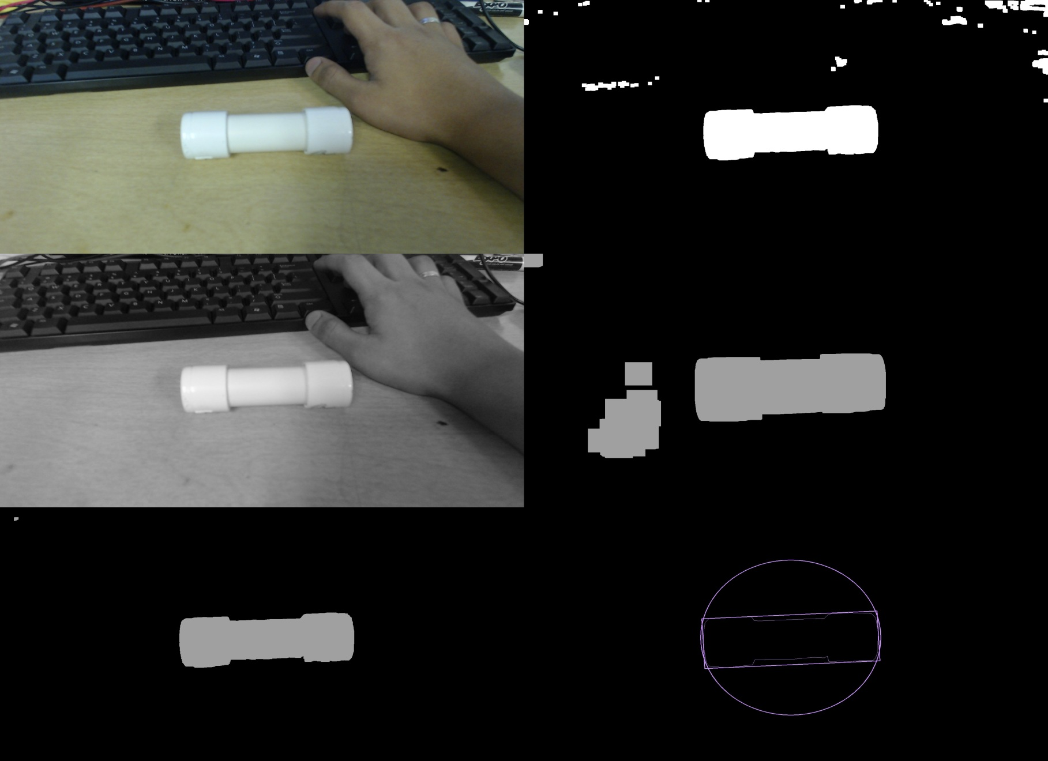
Sample Detection - Preliminary Testing

Slide 2
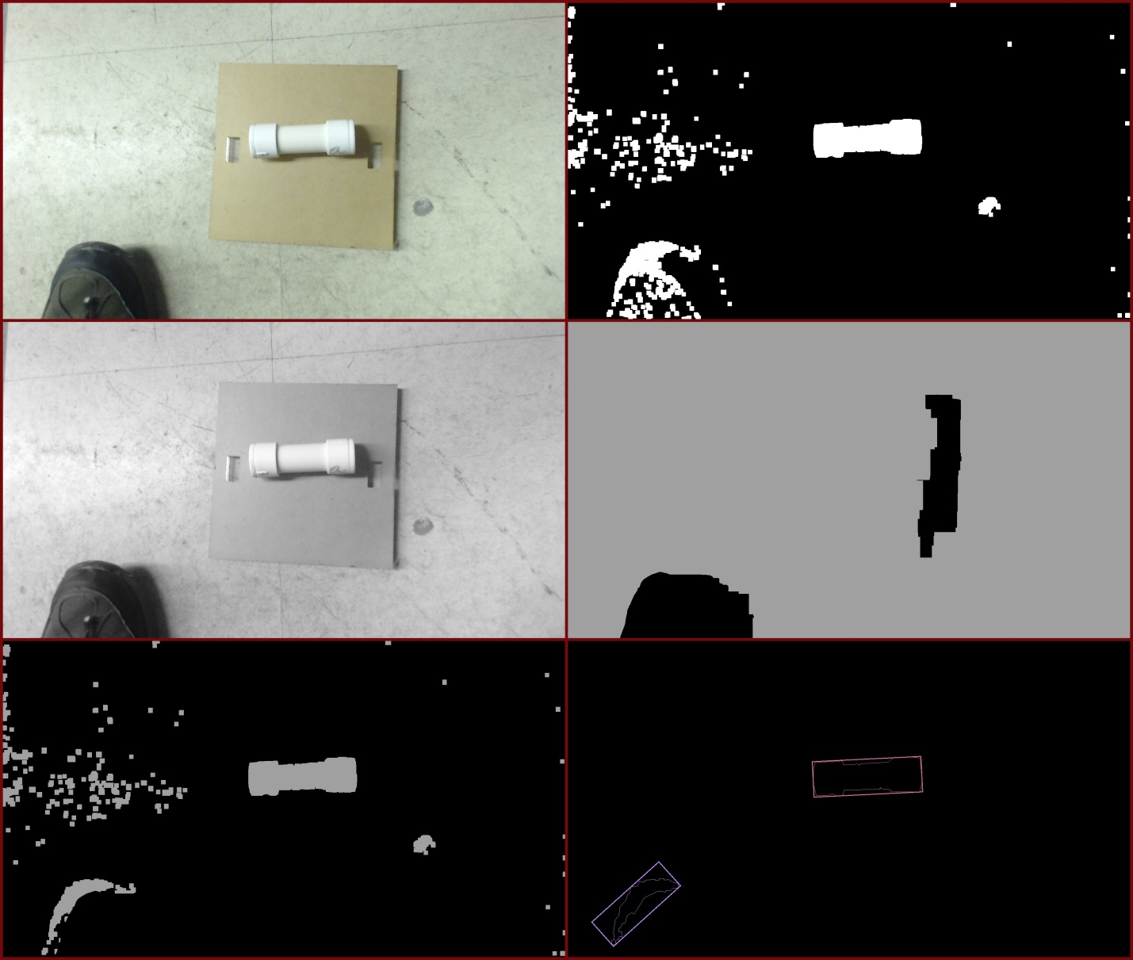
False Positive on Single-level filtering

Slide 3
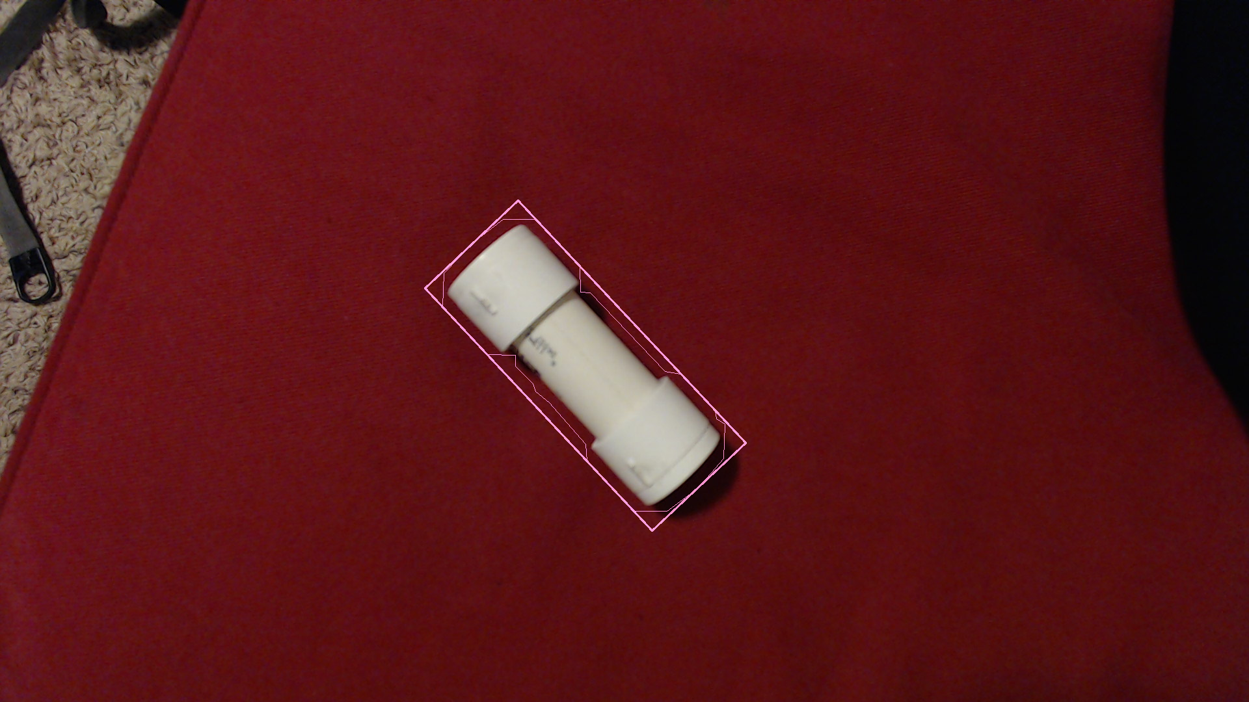
Area-based Filtering

Slide 4
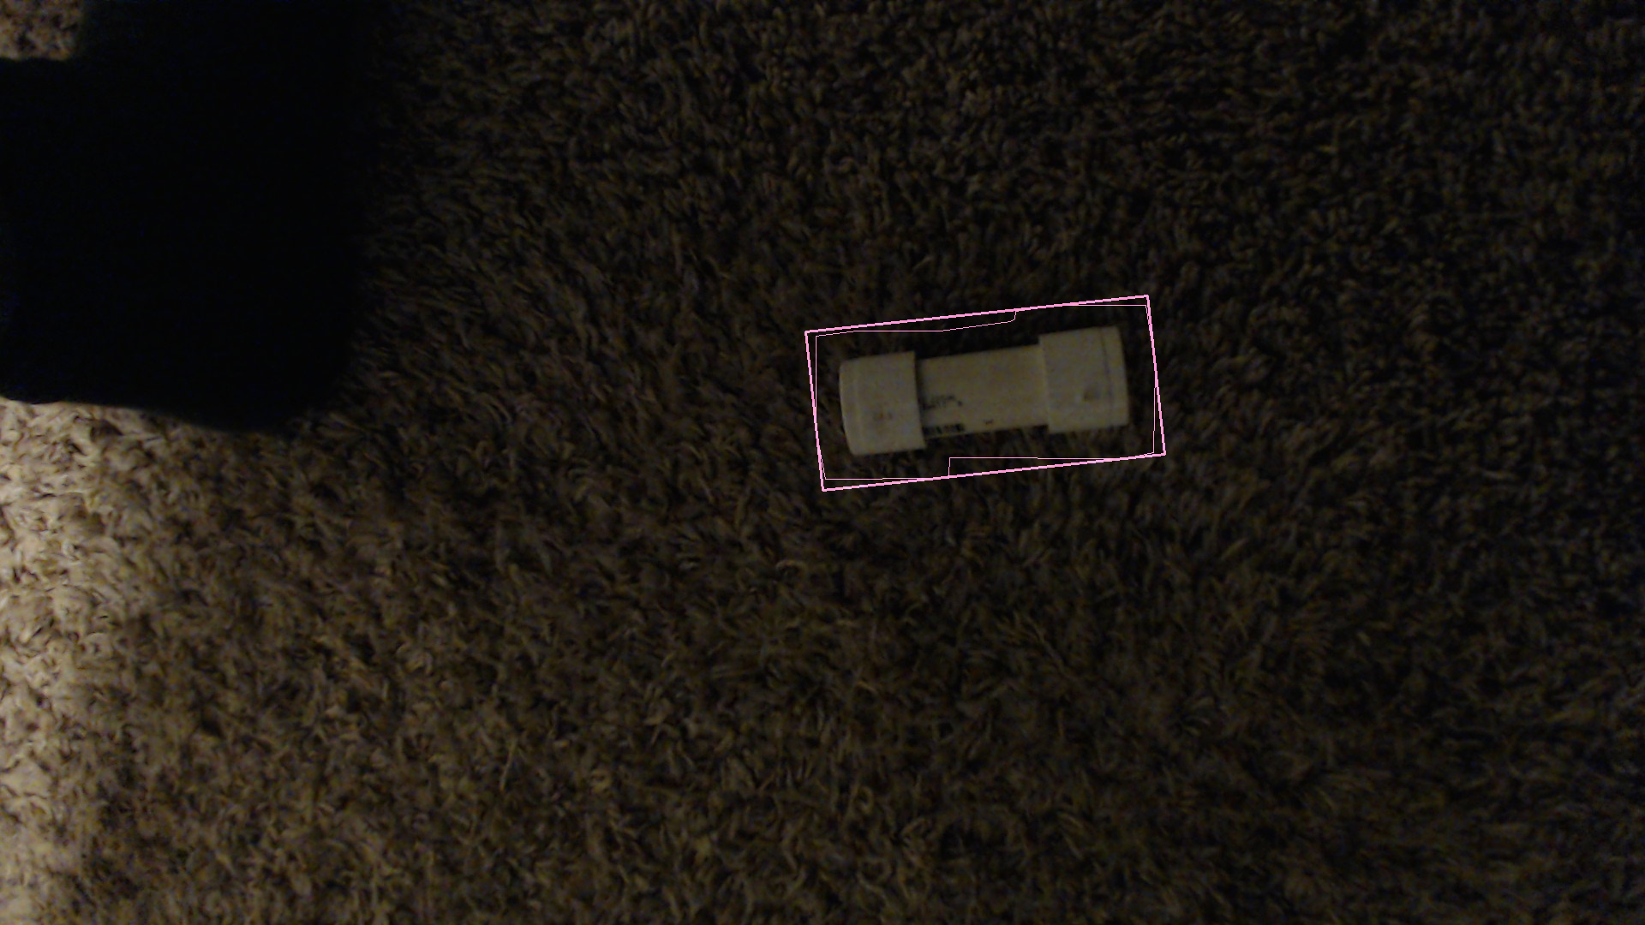
Low-light Detection

Slide 5
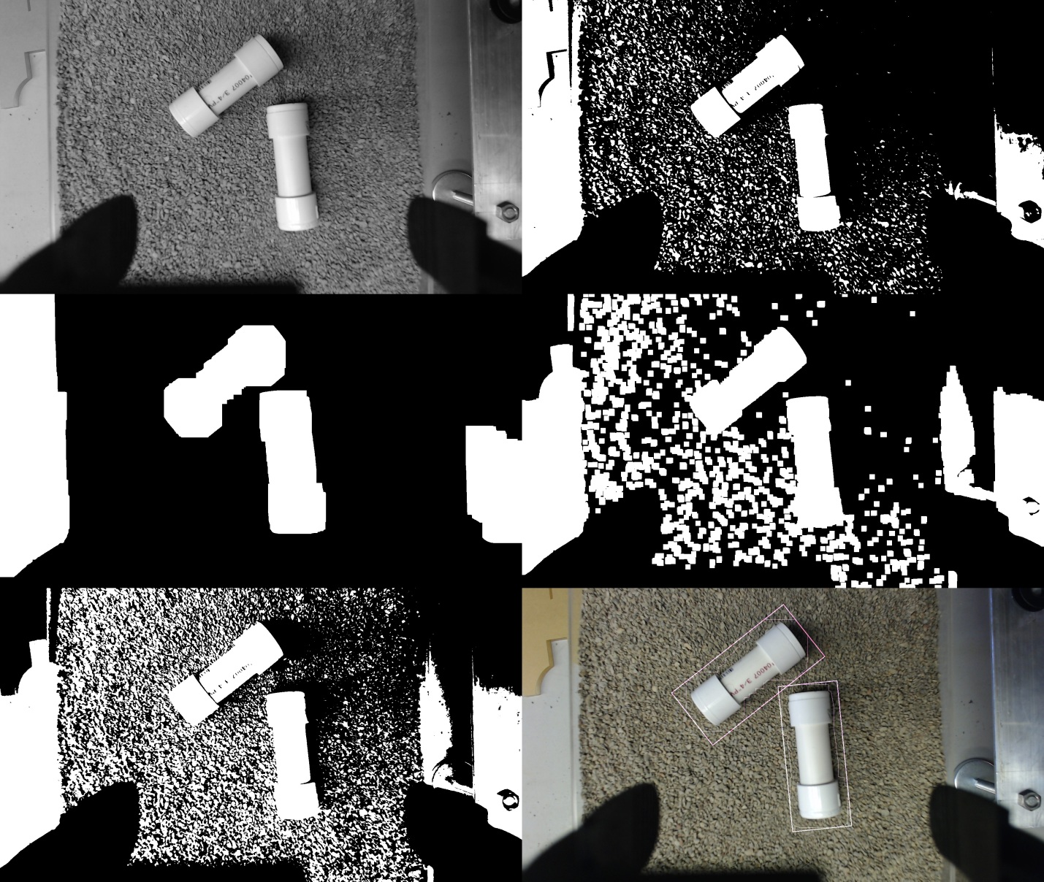
Multiple-Sample Detection

Slide 6
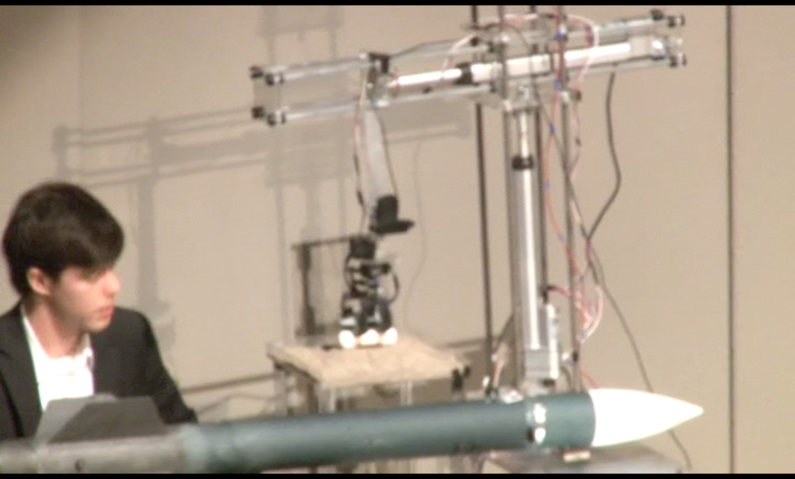
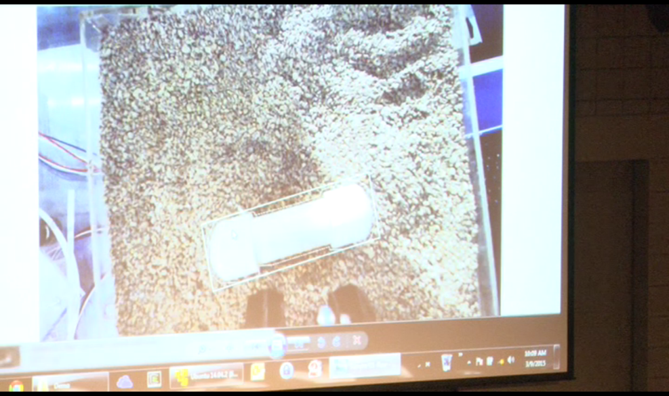
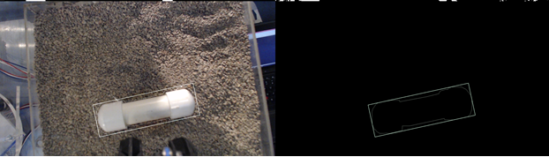
MBA Outreach Sample Detection

Slide 7
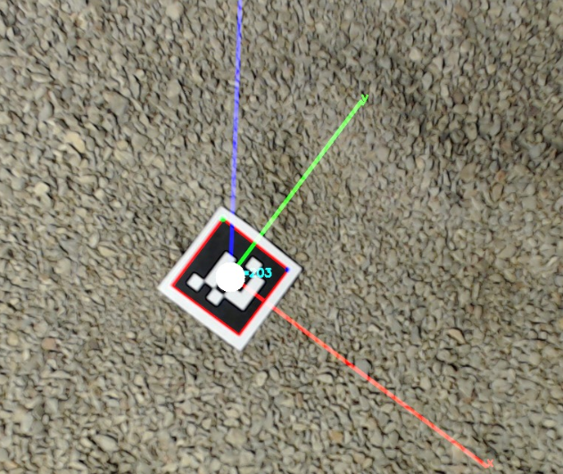
Payload Bay Detection Scheme
Feature-based Tracking
The feature we’re looking for is a distinctive marker
Several markers are placed around the payload bay and provide a clear indication of the position of the camera (and the gripper) relative to the bay.
Each marker has a preprogrammed ID that is used to accurately sense the camera position in 3D space.

Slide 8
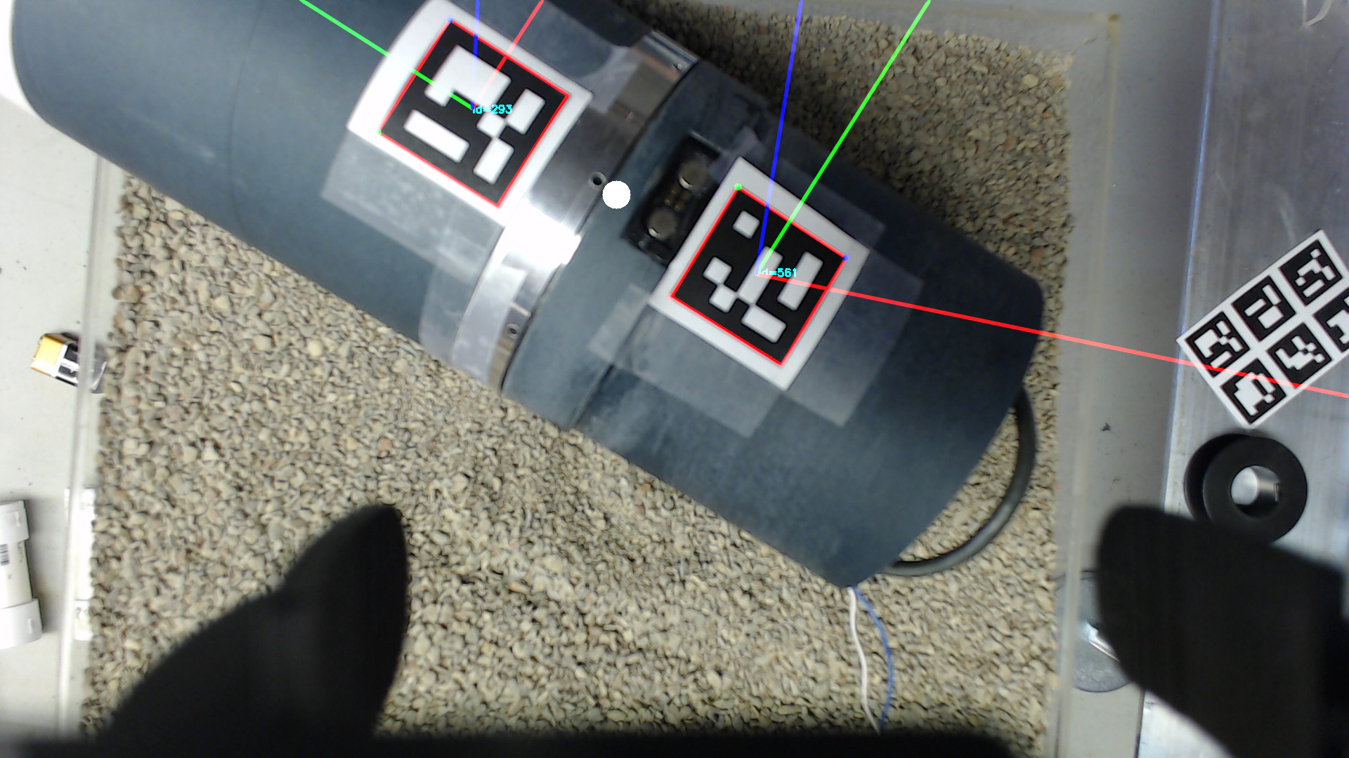
Testing Payload Bay Detection

Slide 9
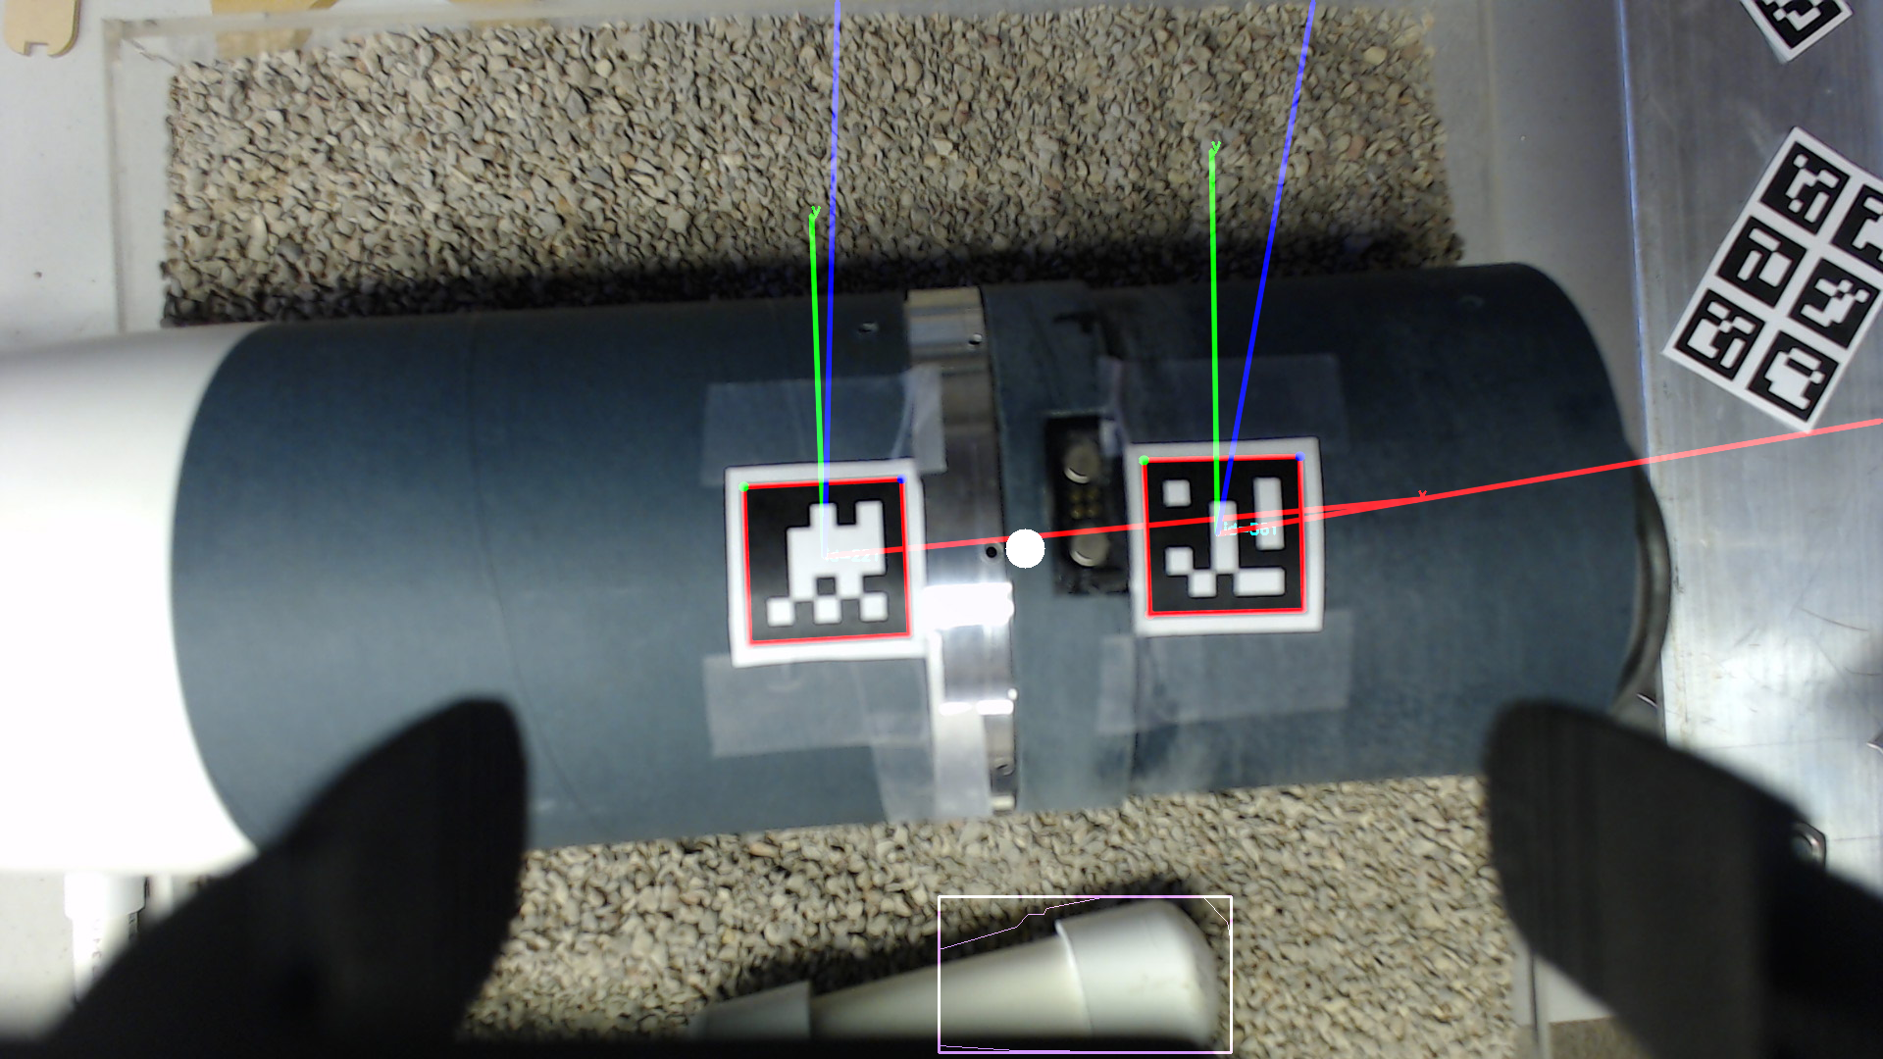
Both Payload Bay & Sample

Slide 10
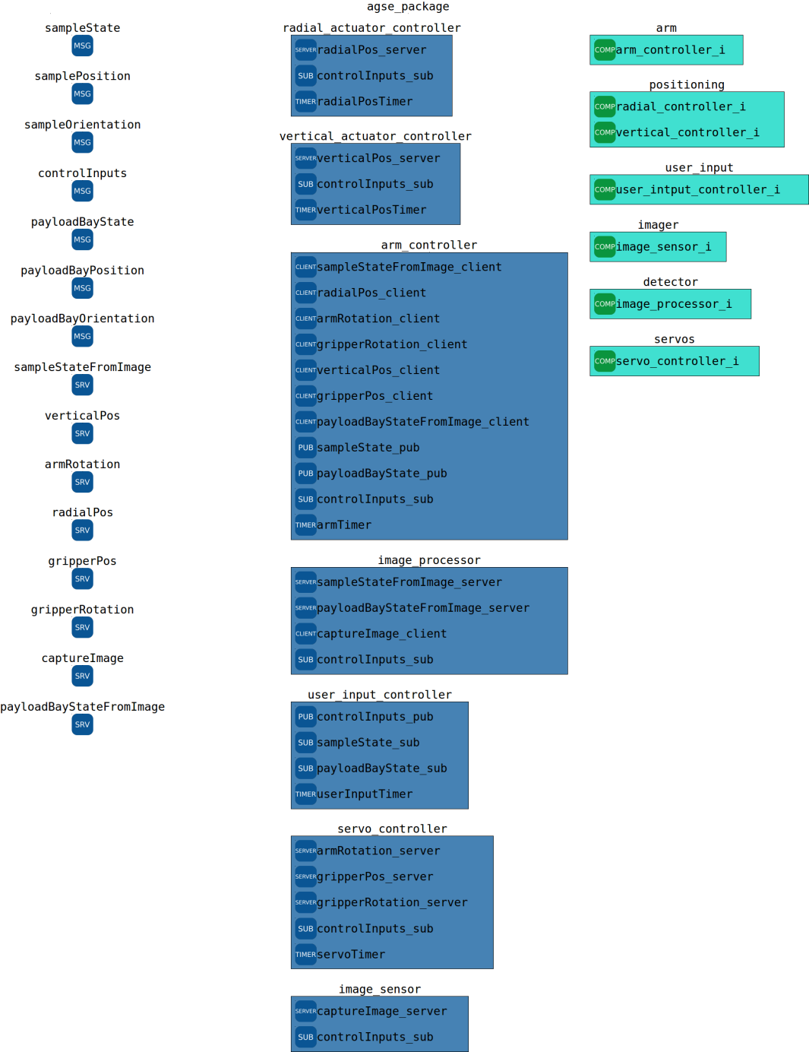
AGSE Software
We have developed a modeling language and graphical editor to describe our software
The software uses ROS for the communications layer
The software is separated into clearly defined components which each execute a single function at a time
The components are deployed into one or more nodes which are processes distributed throughout the system
These components communicate using predefined messages and services

Slide 11
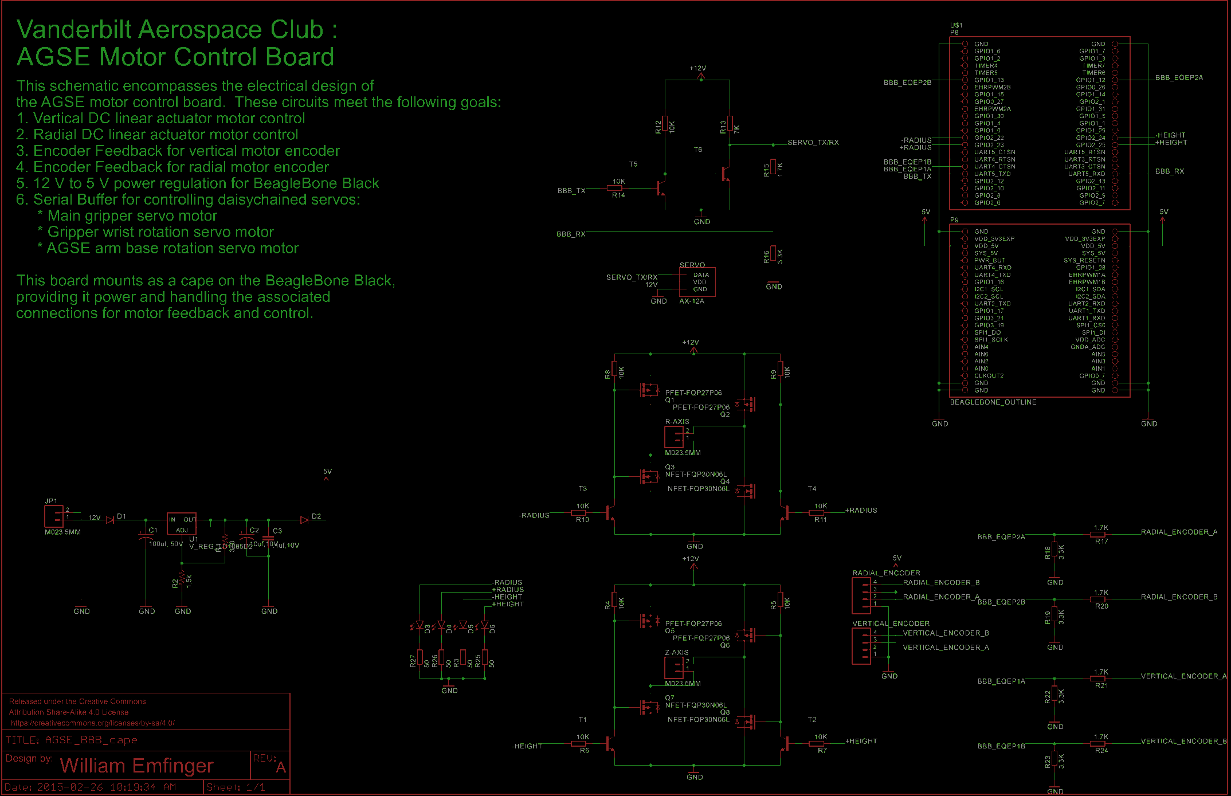
AGSE Circuitry

Slide 12
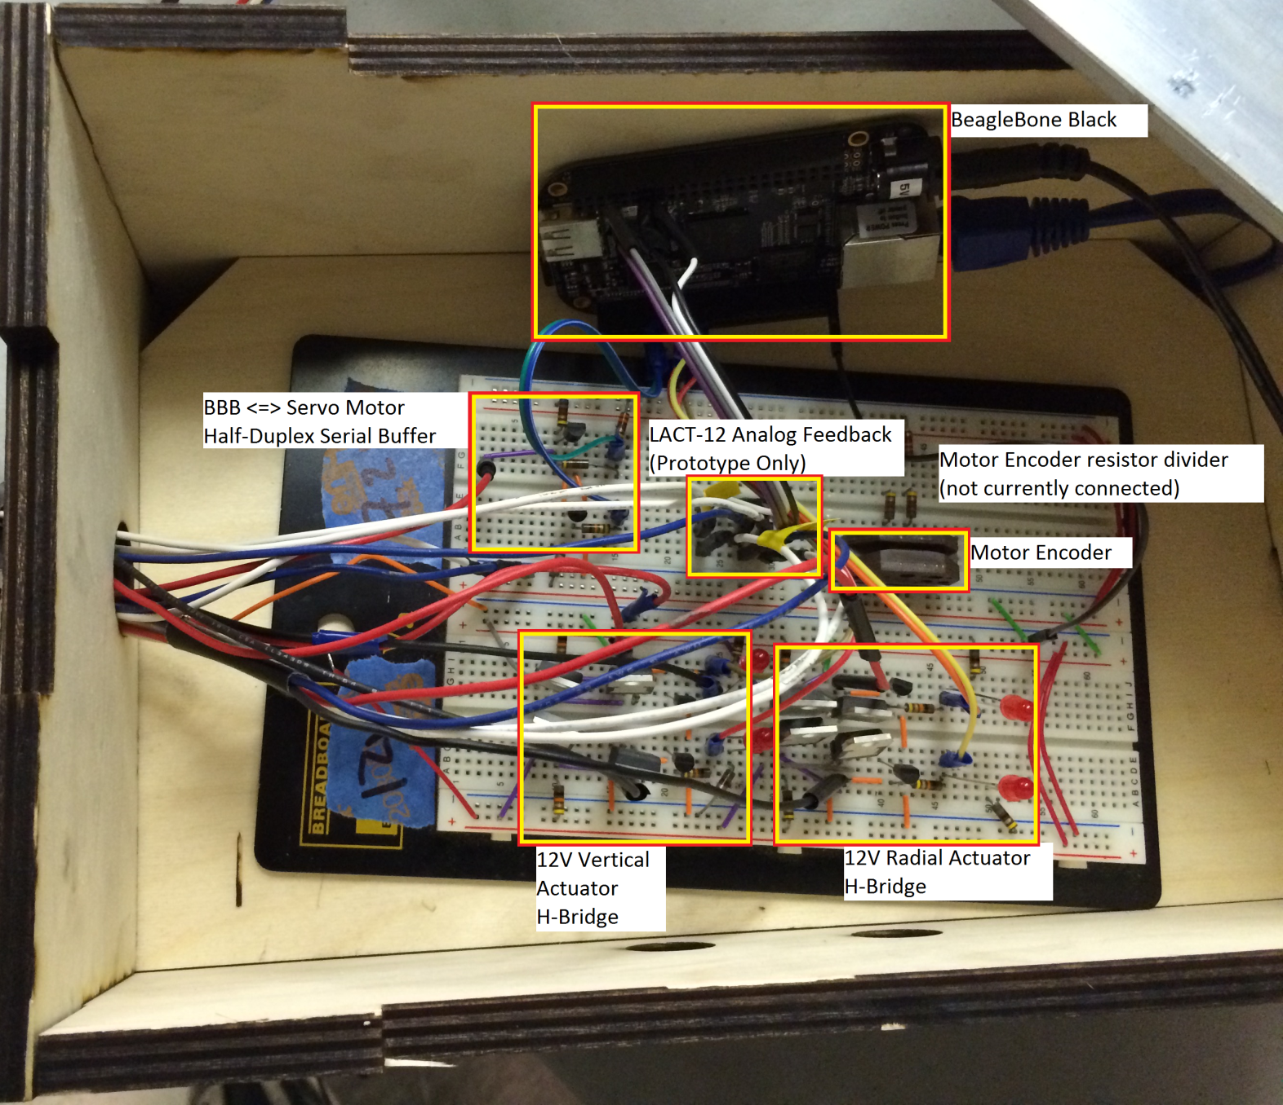
AGSE Circuitry: Prototype

Slide 13
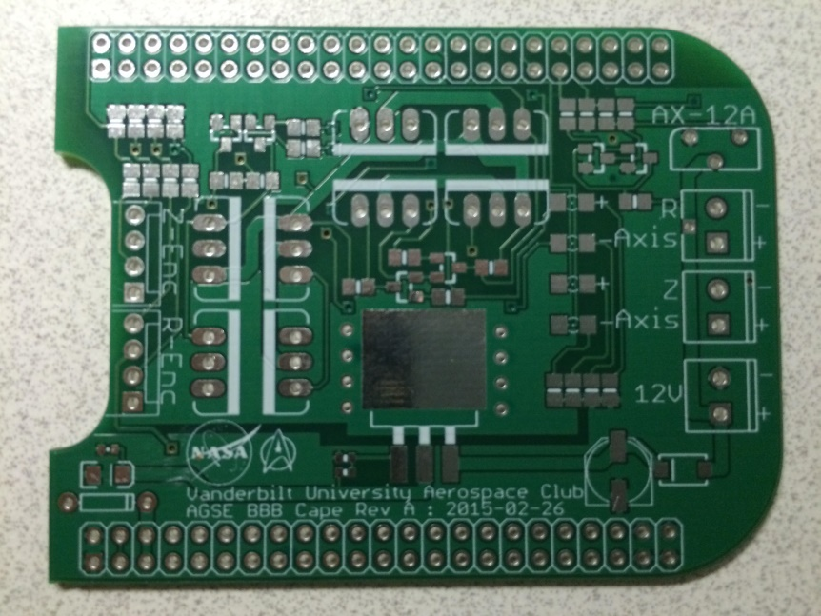
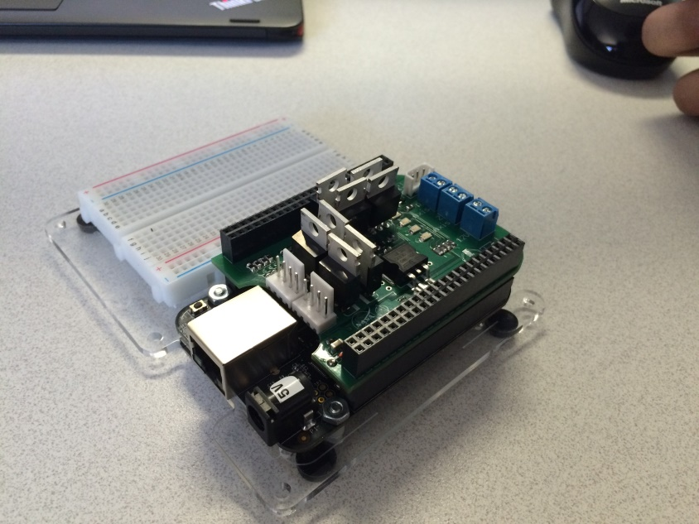
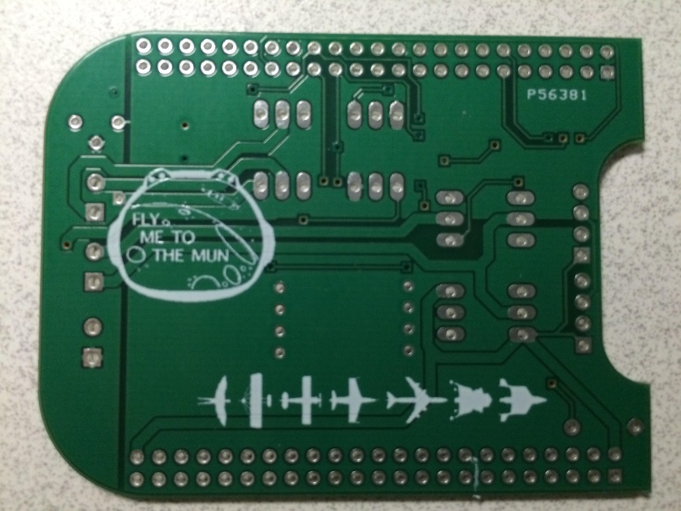
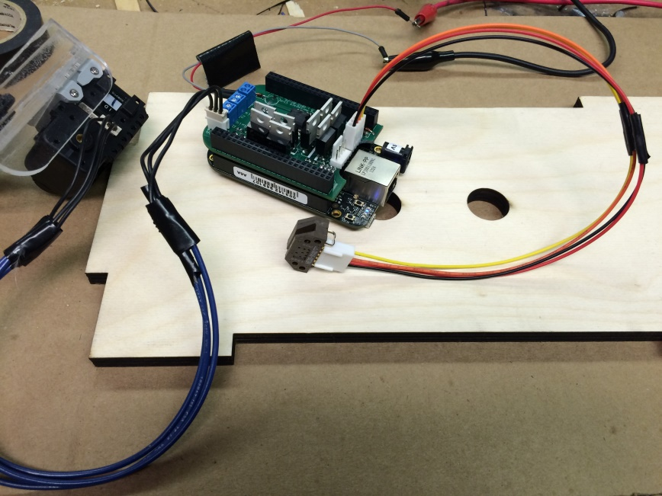
AGSE Circuitry: Final Version

